Slide 1
Angular with Jenkins
JUNE 14 2023
AISWARYA K - 245182
SAGAR SAJI - 245195

Slide 2
Jenkins: What is Jenkins ?
Jenkins is an Open-source automation server that facilitates the continuous integration and continuous deployment (CI/CD) of software projects.
It automate various stages of the software development lifecycle, including building, testing, and deploying applications.
Pipelines define the steps and actions necessary to build, test, and deploy software applications.
One of the pipeline is Scripted Pipeline
Uses Groovy Language to build processes.
More flexible and advanced customization.
Can use conditional statements like if-else or loops to define the workflow.

Slide 3
Jenkins: Jenkinsfile
Before using Scripted Pipeline in Jenkins for a spring boot application, we need to first add a Jenkinsfile into the spring boot application.
Jenkinsfile is a text file that serves as the configuration and definition file for Jenkins pipelines.
It reads and executes the instructions to automate the build, test, and deployment processes.
It specifies the steps, stages, and actions to be executed during the CI/CD process.
Enables version control, collaboration, and automation of their CI/CD processes.
Provides a structured and maintainable approach to defining and executing Jenkins pipelines.

Slide 4
Jenkins: Script Syntax
node {
stage('Build') {
// Build the application
bat 'mvn clean install'
// Perform additional actions within the build stage
bat 'echo "Build completed"'
bat './custom-script.sh'
}
stage('Test') {
// Run unit tests
bat 'mvn test'
// Perform additional actions within the test stage
bat 'echo "Tests completed"'
}
stage('Deploy') {
// Deploy the application to a server
bat 'scp target/app.war user@server:/path/to/deploy'
// Perform additional actions within the deploy stage
bat 'echo "Deployment completed"'
}
}

Slide 5
Why Angular in Jenkins?
Automated Build and Deployment:Jenkins provides automation capabilities, allowing you to set up a pipeline for building, testing, and deploying your Angular application.
Continuous Integration: With Jenkins, you can integrate your Angular application with version control systems like Git. Jenkins can automatically trigger builds whenever changes are pushed to the repository.
Build and Test Automation:Jenkins can execute commands like installing dependencies, building the Angular application, and running tests as part of the build process.
Integration with Other Tools: Jenkins integrates well with various tools commonly used in the Angular ecosystem, such as npm, Node.js, Git, and artifact repositories.
Extensibility: Jenkins offers a vast array of plugins and extensions that allow you to extend its functionality and customize your build and deployment pipeline

Slide 6
Angular in Jenkins: Steps
Checkout SCM: Source code of a software project is retrieved or "checked out" from a source code management (SCM) system like Git.
Install Node Modules: Here “npm install” is being executed inorder to install the node modules.
Build: Here “ng build” is being done to build the application at production environment.
Copy: To copy files and directories from one location to another. The built files of the Angular application are copied from the Jenkins workspace to the specified location, allowing the application to be deployed and accessed through a web server or hosting service.

Slide 7
Angular in Jenkins: Steps
Docker Build: Creating a docker image from a Dockerfile
Docker Run: Create and run a new container from a Docker image
Docker Image: To view the images that are created in the Docker
Docker Push: To push the Docker Image into the specified docker repository

Slide 8
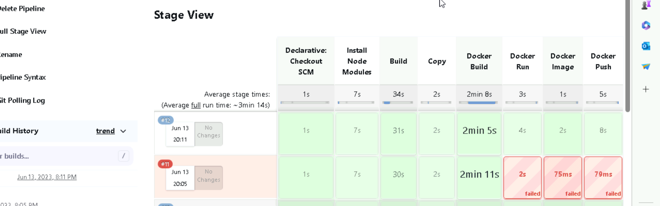
Jenkins Result

Slide 9
Benefits
Continuous Integration
Build Automation
Scalability and Parallel Builds
Integration with Source Control
Testing and Quality Assurance
Deployment Automation
Monitoring and Notifications
Extensibility and Customization

Slide 10
References
https://github.com/sagarsaji/Grade_Calculator_Angular
https://www.youtube.com/watch?v=LxetFijn_D8&t=458s

